Slide 1

Practical Exercise
What might it be like to live with cataracts?
Notes:
Use this exercise to demonstrate what it might be like to be temporarily visually impaired.

Slide 2
Instructions:
Trace mask onto a piece of thin cardboard
Cut out mask shape
Cover the eye holes with the tracing paper
Fold along the dotted line
Punch two small holes at the outer edges and insert the elastic – enough to fit around a person’s head
Decorate as required!
Equipment needed:
Scissors
Roll of tracing paper
Single hole punch
Elastic
Thin card

Slide 3
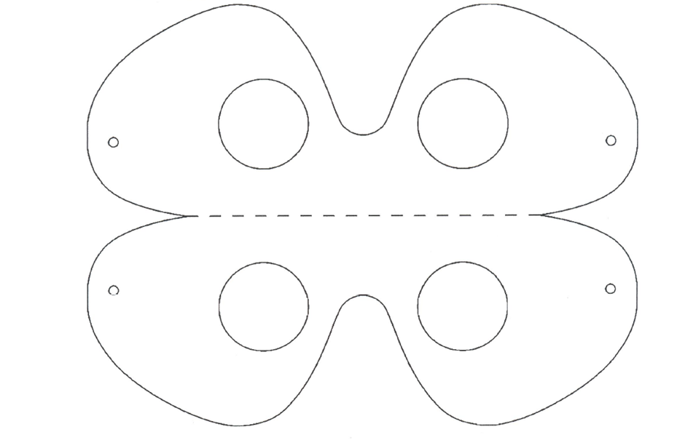


Slide 4
Exercise:
Ask the students to hand over an item belonging to them – shoe, jumper, stationery etc. to the teacher.
In pairs, one of the students wears a blindfold
The teacher takes the items and places them around the room
The blindfolded student is guided by the other student to find their item
(Remember to be mindful of trip hazards)
When all the blindfolded students have retrieved their items discuss as a class how it felt to be temporarily visually impaired.
  Did the navigator push the blindfolded student rather that guide them?
  Did the blindfolded student feel helpless and exposed?
  What challenges did the pair come across?

